Slide 1
Runtime Environments
Dr. K. M. Azharul Hasan
Dept. of CSE, KUET.

Slide 2
Issues for source languages
A program is made up of procedures.
There are differences between the source text of a procedure and its activation at run time.
A procedure definition is a declaration that associates an identifier with a statement.
    Identifier is a procedure name
    The statement is the procedure body

Slide 3
Activation Trees
Flow of control among procedures during execution of a program
  Control flows sequentially
  Each execution of a procedure starts at the beginning of the procedure body and eventually returns to the point immediately following the place where the procedure was called.

Slide 4
Activation Trees
Each execution of a procedure body is referred to as an activation of the procedure.
Lifetime of an activation of a procedure P is the sequence of steps between the first and last steps in the execution of the procedure body
  including time spent executing procedures called by P, the procedures called by them and so on.

Slide 5
Activation Trees
If a and b are procedure activations, then there life times are either non-overlapping or are nested.
A procedure is nested if a new activation can begin before an earlier activation of the same procedure has ended.

Slide 6
Activation Trees
We can use activation tree to illustrate the way control enters and leaves activations.
In an activation tree
  Each node represents an activation of a procedure
  The root represents the activation of the main program
  The node a is the parent of the node b iff control flows from the activation a to b, and
  The node a is left of the node b iff the lifetime of a occurs before the lifetime of b.

Slide 7
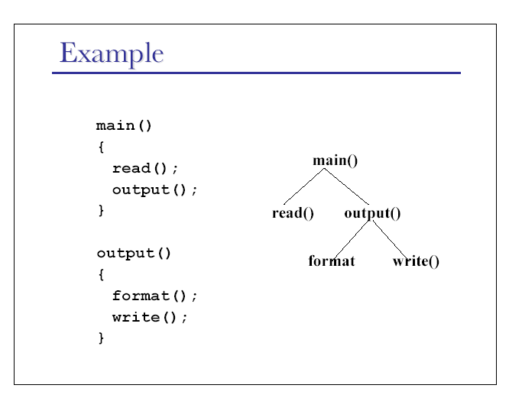
Activation Trees
main()
gcd(15,10)
gcd(10,5)
gcd(5,0)

Slide 8
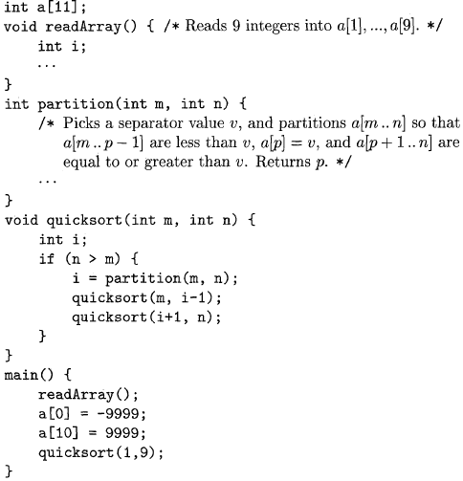
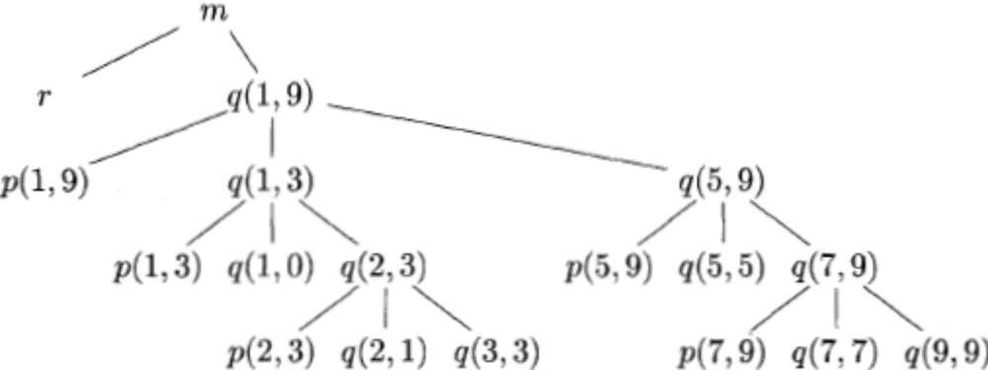
Activation Trees
Only the first word of the procedure name is used.

Slide 9
Control Stacks
The flow of control in a program corresponds to a depth-first-traversal of the activation tree
  starts at the root
  visit a node before its children
  recursively visits children at each node in a left-to-right order.
We can use a stack, called control stack to keep track of live procedure activations.

Slide 10
Control Stacks
Push the node for an activation onto the control stack as the activation begins and pop the node when the activation ends.
  Contents of the stack are related to paths to the root of the activation tree.
  When node n is at the top of the control stack, the stack contains the nodes along the path from n to the root.

Slide 11
Storage Organization
The compiler obtains a block of storage from the operating system for the compiled program to run in.
Run time storage might be subdivided to hold
  The generated target code
  Data objects, and
  A counterpart of the control stack to keep track of procedure activations.

Slide 12
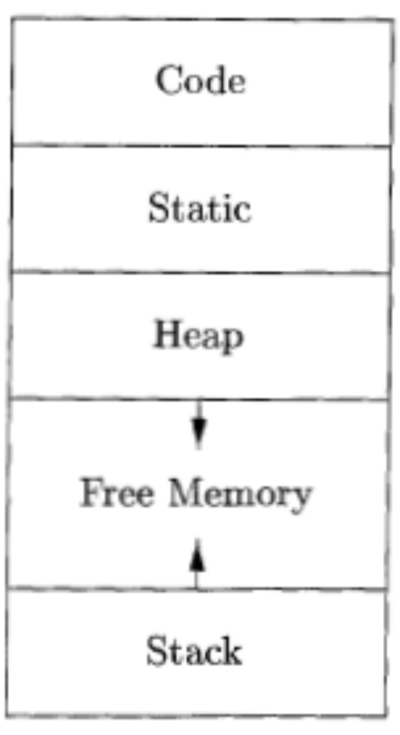
Storage Organization
Value of registers and program counter stored on stack
The size of stack and heap can change
The language that does not have activation facility uses heap

Slide 13
Storage Organization
In most compiled languages
  It is not possible to make changes to the code area during execution.
  The code area is fixed prior to the execution,
  All code addresses are computable at compile time.
  The size of some data objects may also be known at compile time,
  These can also be placed in a statically determined area.

Slide 14
Activation records
Procedure calls and returns are managed by a run-time stack called the control stack.
  Each live activation has an activation record
  The root of activation tree is at the bottom of the stack
  The current execution path specifies the content of the stack with the last activation has record in the top of the stack.

Slide 15
A General Activation Record
Returned value
Actual parameter
Optional control link
Optional access link
Saved machine status
Local data
temporaries
Returns a value to the calling procedure
The parameters to the called procedure
Points to the activation record of the caller
To refer to nonlocal data held in the other activation records
Information about the state of the machine just before the proc is called
Local data
temporaries

Slide 16
Storage allocation strategies

Slide 17
Storage Organization
A compiler must allocate resources for target machine to represent the data objects manipulated by the source program.
Three strategies to locate and manage the storage of data
  Static allocation: determines the size and relative position of each object at compile time that may have at run time. Example: FORTRAN.
  A recursive procedure may have more than one activation at a given instant at run time. Dynamic allocation scheme involving stack is usually used. Example: ALGOL
  One more scheme that allocates and frees the memory in non nested fashion, The storage area where allocation and de allocation is used is called heap. Example: PL/I.

Slide 18
Static allocation
Statically allocated names are bound to re locatable storage at compile time.
Storage bindings of statically allocated names never change.
The compiler uses the type of a name (retrieved from the symbol table) to determine storage size required.
The required number of bytes (possibly aligned) is set aside for the name.
The re locatable address of the storage is fixed at compile time.

Slide 19
Static allocation
Limitations:
  The size required must be known at compile time.
  Recursive procedures cannot be implemented statically.
  No data structure can be created dynamically as all data is static.

Slide 20
Dynamic allocation
Storage is organized as a stack.
Activation records are pushed and popped.
Locals and parameters are contained in the activation records for the call. This means locals are bound to fresh storage on every call.
Need a stack_top pointer. To allocate a new activation record, increase stack_top.
To deallocate an existing activation record, decrease stack_top.

Slide 21

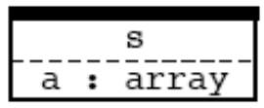



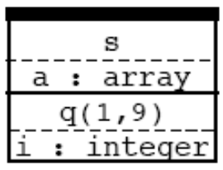
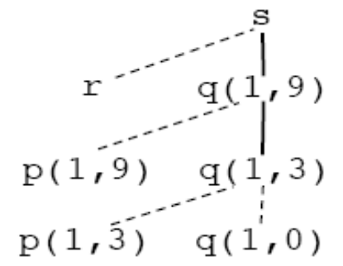
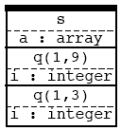
Position in Activation Tree | Activation Records on the Stack
Frame for S
r is activated
r popped and q pushed
Control returned to q(1,3)

Slide 22
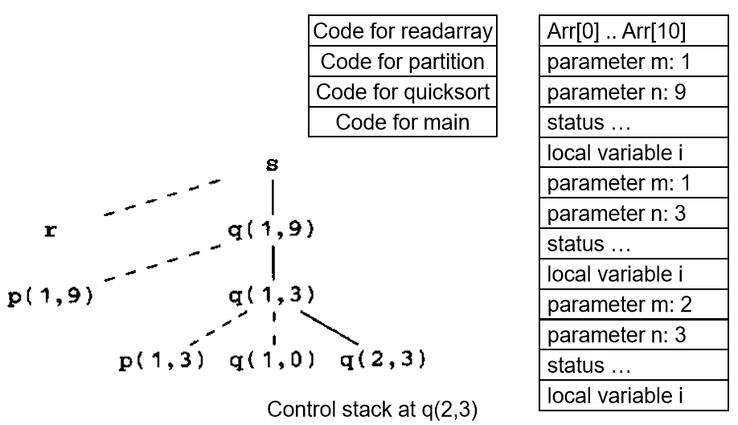
Stack of activation records-Example

Slide 23
Variable-length data
In some languages, array size can depend on a value passed to the procedure as a parameter.
Variable-sized data can still be allocated on the stack, but below the callee’s activation record.
Simply store pointers to the to-be-allocated data.

Slide 24
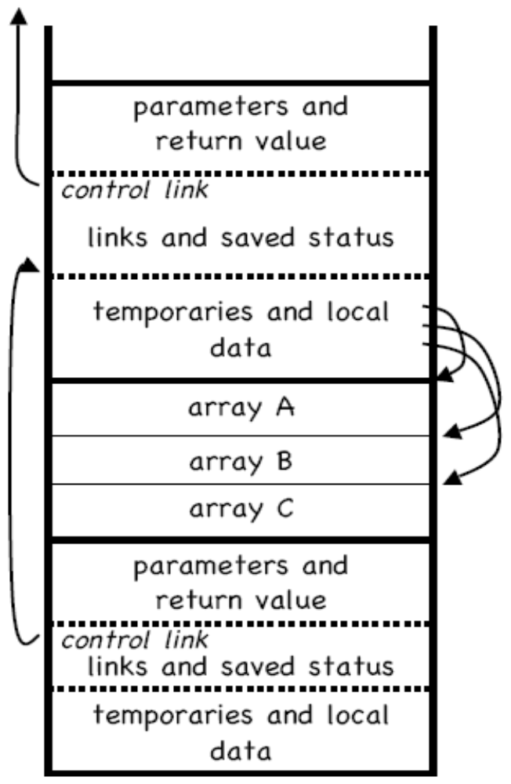
Example of variable- length data
All variable-length data is pointed to from the local data area.

Slide 25
Heap Allocation
    Heap allocation -- allocates and deallocates storage as needed at runtime from a data area known as heap.
      Most flexible: no longer requires the activation of procedures to be LIFO.
      Most inefficient: need true dynamic memory management.

Slide 26
Heap Allocation
  General Rule
    maintain list of free blocks
    allocate block of appropriate size
    handle fragmentation
    handle garbage collection
    Note: static allocation too restricted, heap allocation too inefficient. Most current compiler/language/processor uses the stack allocation scheme.

Slide 27
Thank You

